Slide 1


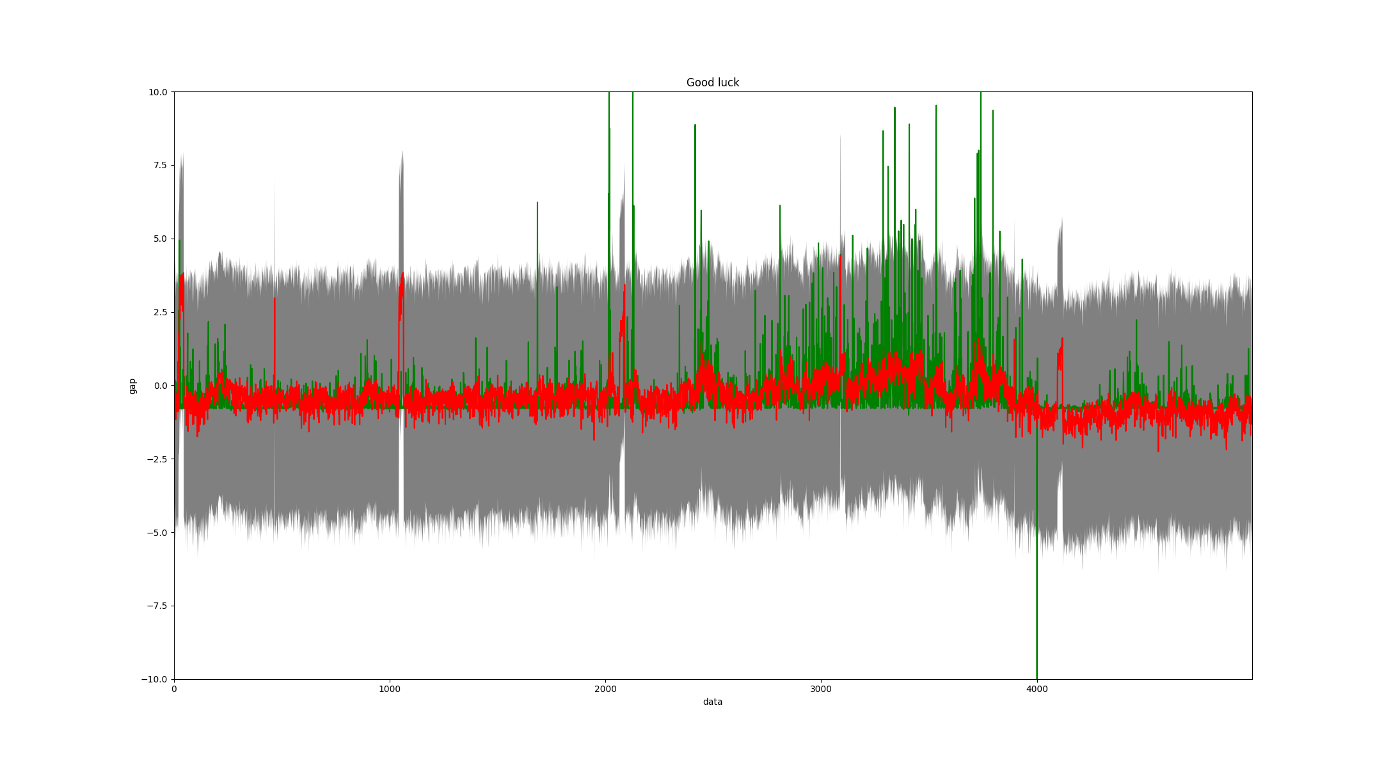
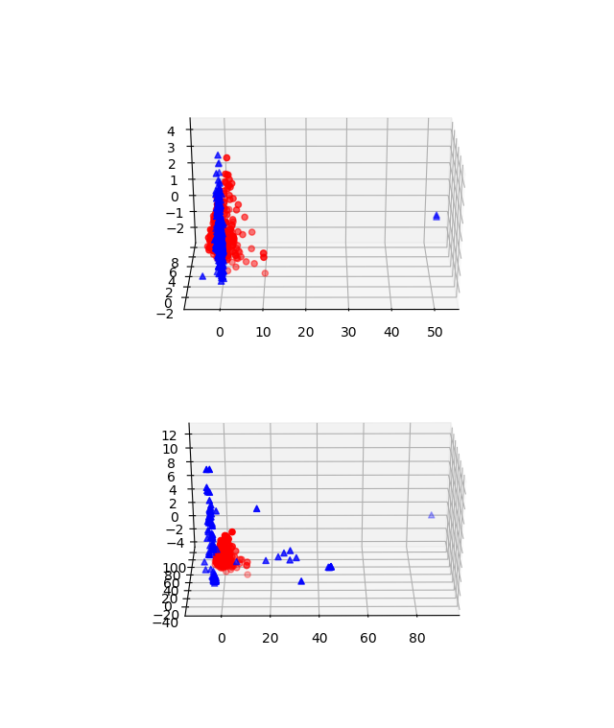
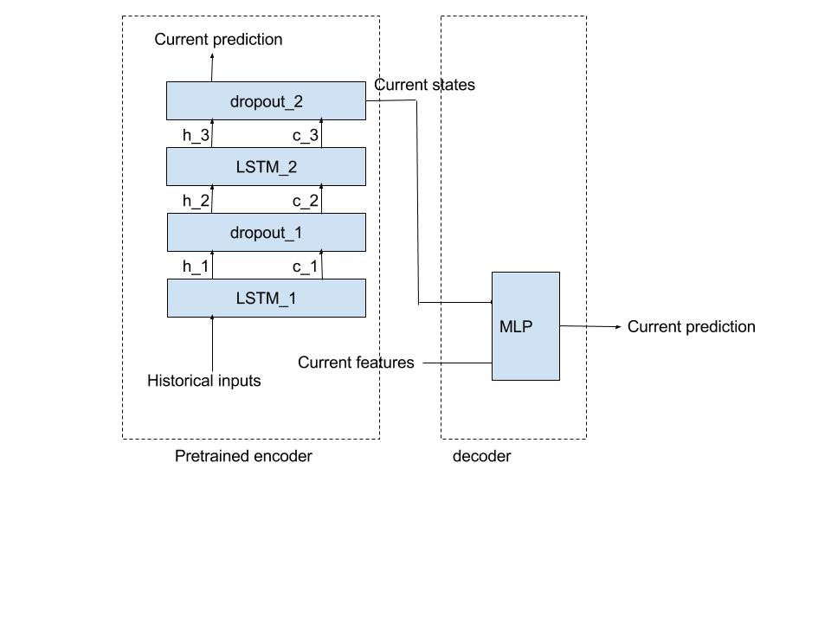
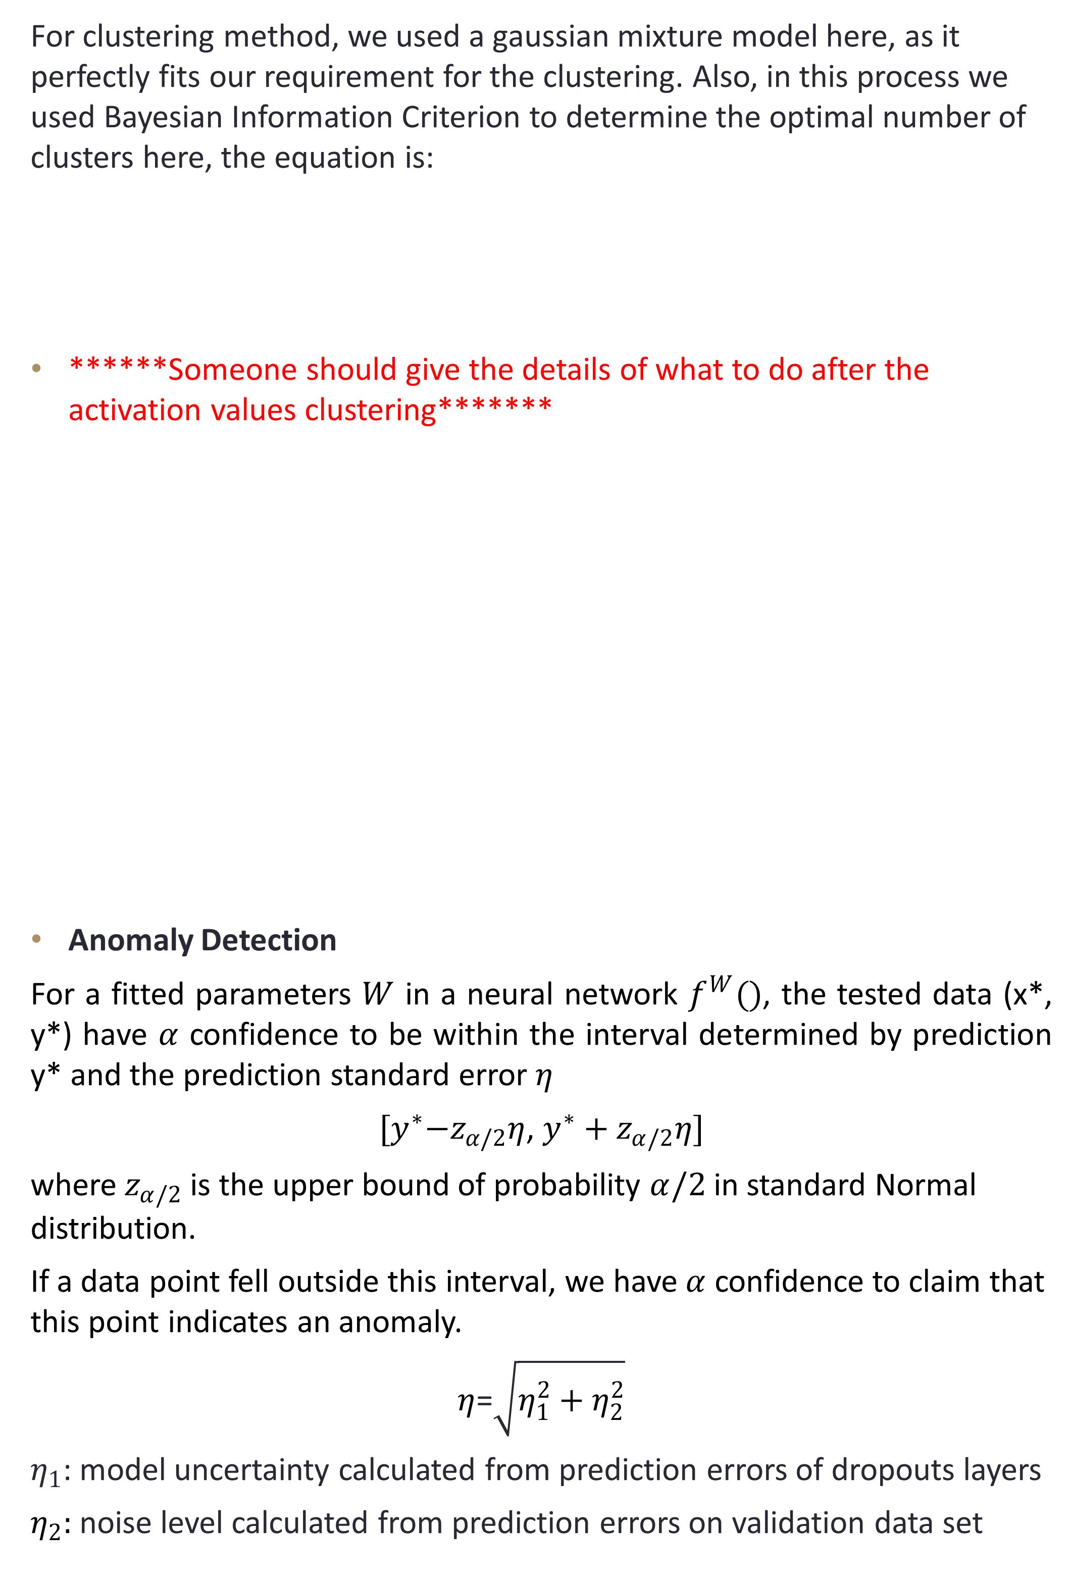
Trends and Anomalies Detection on SICK Sensor Data
Akash Mehta, Muhammad Zuhayr, Weichao Zhou, Shen Han
Project task
For clustering method, we used a gaussian mixture model here, as it perfectly fits our requirement for the clustering. Also, in this process we used Bayesian Information Criterion to determine the optimal number of clusters here, the equation is:
******Someone should give the details of what to do after the activation values clustering*******
Anomaly Detection
For a fitted parameters $W$ in a neural network $f^{W}()$, the tested data (x*, y*) have $α$ confidence to be within the interval determined by prediction y* and the prediction standard error $η$
${[y}^{∗}−z_{α/2}η$, $y^{∗}+z_{α/2}η]$
where $z_{α/2}$ is the upper bound of probability $α/2$ in standard Normal distribution.
If a data point fell outside this interval, we have $α$ confidence to claim that this point indicates an anomaly.
$η$=$\sqrt{η_{1}^{2}+η_{2}^{2}}$
$η_{1}$: model uncertainty calculated from prediction errors of dropouts layers
$η_{2}:$ noise level calculated from prediction errors on validation data set
evaluation
As sensors are the critical components in the modern industrial automation field, the data they perceive can bring us plenty information and insights on the status of the automatic production line. The goal of our project is to explore and dig out the potential trends as well as detect the hidden anomalies among the massive sensor data. To be more specific, in SICK’s logistics automation facility, objects on conveyor will be labeled as legal for trade (LFT) or not legal for trade (NotLFT) by sensors when passing through the “camera tunnel”. While the rules of this labelling process is hardcoded somehow, a view from overall statistic perspective would be valuable here to examine whether the system is working normally. That is to say, by learning the underlying trends between the label and other physical attributes here, we can extract the overall running condition of the facility, which can be provided to automation engineers for further analyses.
SVM test result on 2017-07-06 dataset (All physical data as input, LFT as output)
Kernel & Params | Precision | recall | F1-score
RBF, 1/N gamma | 0.96 | 0.76 | 0.85
POLY, 1/N gamma, 3 degree, 0 coef0 | 0.956 | 0.89 | 0.92
Linear | 0.95 | 0.58 | 0.72
Sigmoid, 1/N gamma, 0 coef0 | 0.93 | 0.51 | 0.66
objectives
Extract the package trends lying in the SICK data w.r.t LFT and NotLFT
Investigate “Gap” information and determine if there are outliers by proposing a reasonable model dealing with temporal information.
Approach
Our approach divides into two parts
Trends Learning
******Someone should explain a little bit about the model of out MLP and why it’s that*******
We firstly utilized a general SVM classifier with different kinds of kernel to explore the potential relationship. This step served as an inspiration of what is the seasonable input and output of our MLP, in what extent of complicated we should design our structure to avoid overfitting. A typical result of our SVM is shown as left figure.
Gap value
True value
Predicted value
Acceptance interval with 0.95 confidence
Objects detected in time series
conclusions
Conclusion 1
Conclusion 2
We proposed an approach combining MLP with LSTMs to detect anomaly.

